Slide 1

SRES’
SANJIVANI COLLEGE OF ENGINEERING
KOPARGAON 423 603 (M.S.)
Department of
Electronics & Telecommunication Engineering
2018-19.
MEGA PROJECT PRESENTATION
PROJECT GROUP NO: 31

Slide 2
PROJECT GROUP NO.: 31.
PROJECT GROUP MEMBERS:
SR. NO. | ROLL NO. | NAME
01 | 101 | Maniyar Akib M.
02 | 110 | Muley Rasika R.
03 | 146 | Sheikh Masem M.
PROJECT GUIDE: PROF. D. G. LOKHANDE

Slide 3
Project Title: “SMART FARMING”.
Domain / Field of specialization:
- Agricultural Engineering.
- Embedded System.
- IoT.
PROJECT DEFINITION:
AIM OF THESE SYSTEM IS TO INTRODUCE THE LATEST TECHNOLOGY INTO THE AGRICULTURE BUSINESS AND BETTER CROP PRODUCTION BY COLLECTING REAL-TIME STATUS OF CROP AND INFORMING THE FARMER ABOUT IT.

Slide 4
OBJECTIVES:
THE TECHNIQUE IS CAN GRASP BY THE FARMER QUICKLY IN THE AGRICULTURE BUSINESS.
TO MEASURE PARAMETER LIKE TEMPRETURE, CHEMICAL IN THE SOIL, MOISTURE CONTENT, HUMIDITY.
TO AUTOMATE WATER PUMP MOTOR DEPENDING ON WATER % IN SOIL.
TO INNOVATE THE LANDSCAPE FOR CURRENT FARMING METHODS.

Slide 5
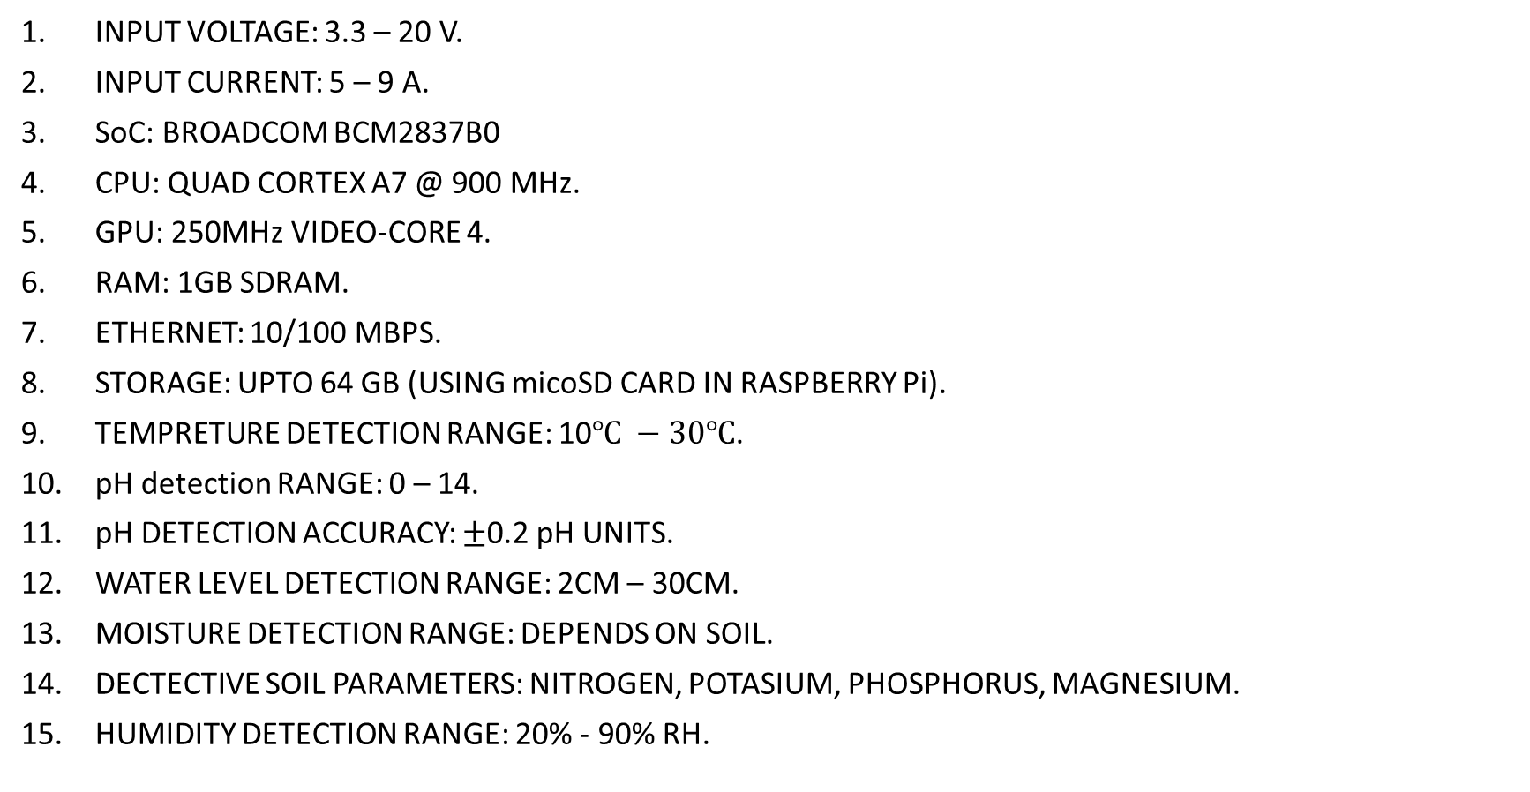
HARDWARE SPECIFICATION :
INPUT VOLTAGE: 3.3 – 20 V.
INPUT CURRENT: 5 – 9 A.
SoC: BROADCOM BCM2837B0
CPU: QUAD CORTEX A7 @ 900 MHz.
GPU: 250MHz VIDEO-CORE 4.
RAM: 1GB SDRAM.
ETHERNET: 10/100 MBPS.
STORAGE: UPTO 64 GB (USING micoSD CARD IN RASPBERRY Pi).
TEMPRETURE DETECTION RANGE: 10$℃ −30℃$.
pH detection RANGE: 0 – 14.
pH DETECTION ACCURACY: $±$0.2 pH UNITS.
WATER LEVEL DETECTION RANGE: 2CM – 30CM.
MOISTURE DETECTION RANGE: DEPENDS ON SOIL.
DECTECTIVE SOIL PARAMETERS: NITROGEN, POTASIUM, PHOSPHORUS, MAGNESIUM.
HUMIDITY DETECTION RANGE: 20% - 90% RH.

Slide 6
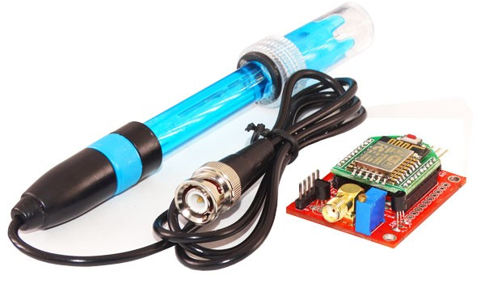
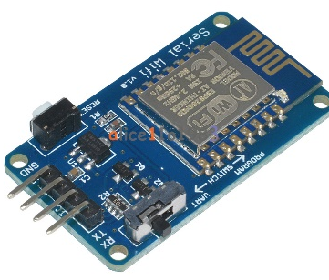
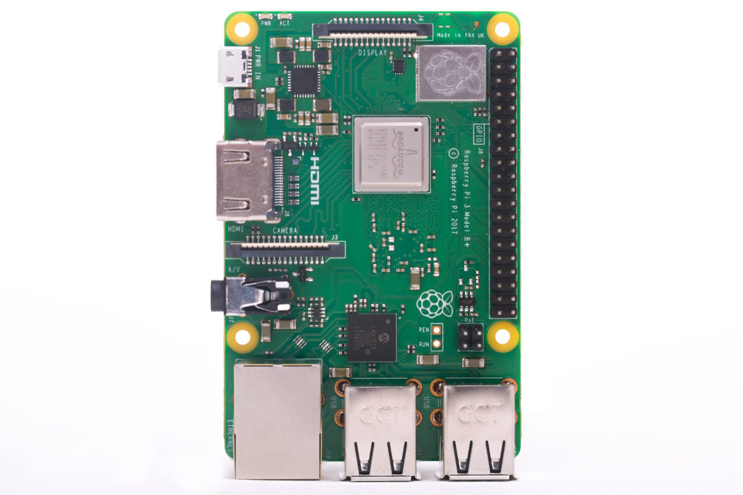
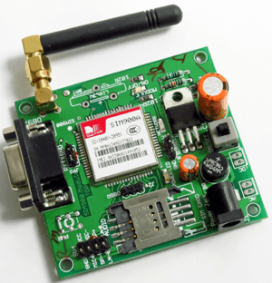
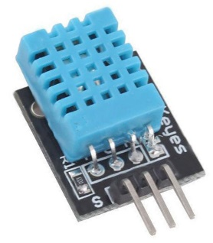
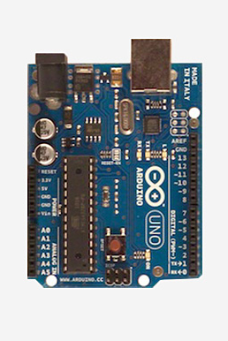
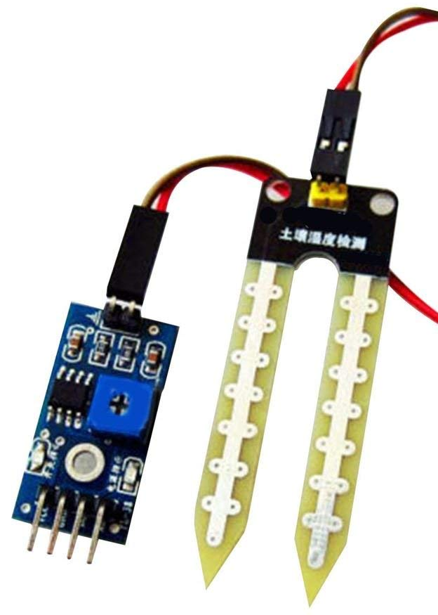
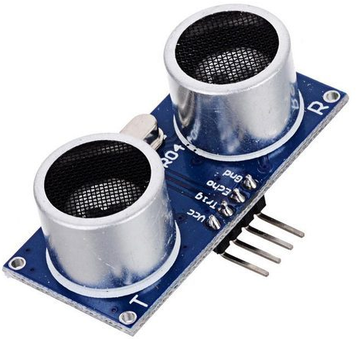
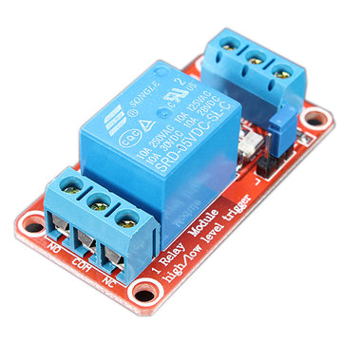
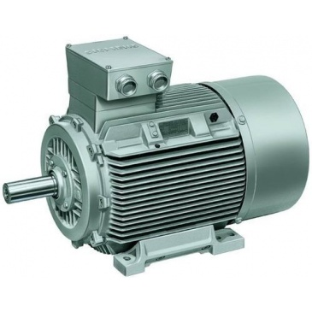
COMPONENTS
REQUIRED
Serial Wi-Fi Module
ESP8266 ESP-12
PH SENSOR MODULE
DHT11 Sensor
Temperature sensor
DHT11 Sensor
Humidity sensor
SIM900A GSM MODEM
MODULE
Raspberry pi Board
Arduino Board
Ultrasonic sensor
For Measuring Water level
Soil Moisture sensor
Relay and Motor

Slide 7
REGULATED POWER SUPPLY
RASPBERRY Pi BORD
ARDUINO UNO
GENEUNO
(ATmega328P).
ARDUINO
pH MODULE
pH SENSOR
CHEMICAL SENSOR
(ELECROCHEMICAL
SENSOR)
ULTRASONIC
SENSOR
SR-04
WATER LEVEL DETECTION

Slide 8

Website(Real time data)
Camera
(For Image processing)
ARDUINO UNO
GENUENO BOARD
Wi-Fi module
ESP8266 - WRL-13678
Raspberry pi
Board
Humidity (DHT 11)
Messaging
(Hourly updates with updating time options )
GSM Module
SIM900A
Temperature Sensor (DHT 11)
Relay driver
+
Relay
Motor Pump
Regulated Power
Supply
5V
Fig : - Block Diagram for Agriculture Automation

Slide 9
ALGORITHM
START
Type of Signal
ANALOG
DIGITAL
Arduino Uno
Raspberry pi 3
Chemical Sensor
A3 Port
Water Level By Ultrasonic sensor
A1 Port
PH sensor
A0 port
Soil moisture sensor
A4 port
Humidity sensor
(GPIO 2)
Temperature sensor
(GPIO 3)
OUTPUT ON WEBSITE
Is Signal digital
YES
NO
Critical Level?
GSM MODULE
SIM900
SMS on mobile
NO
STOP

Slide 10
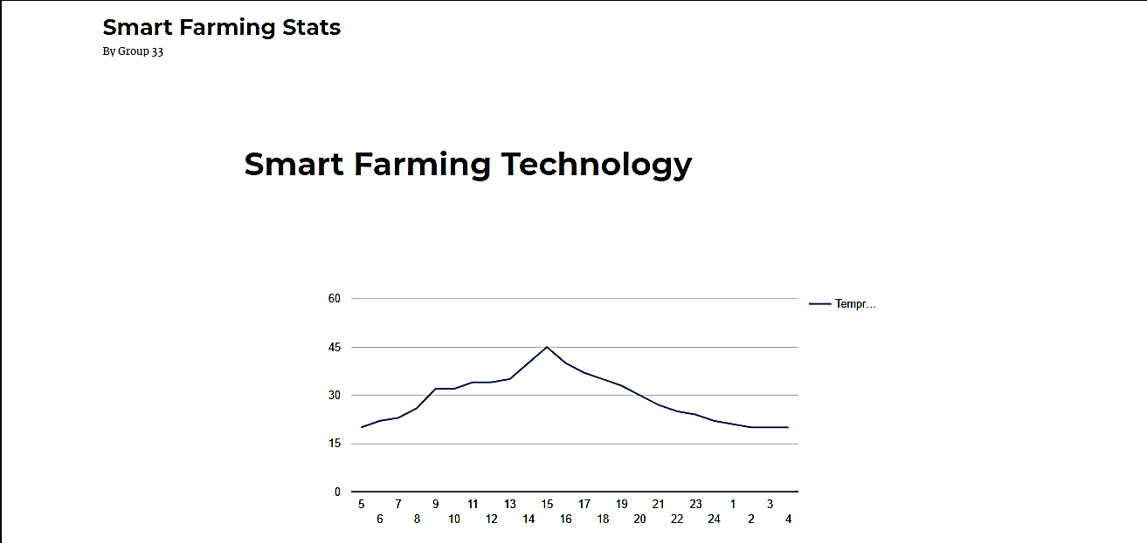
OUPUT WEBSITE

Slide 11
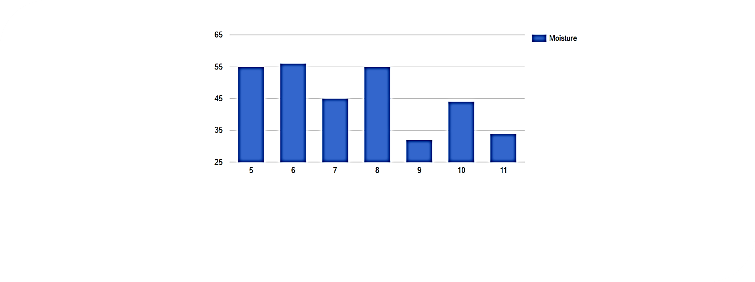


Slide 12
Component Specification
Arduino Technical Specifications:
Microcontroller: ATmega328P.
Operating Voltage: 5V.
Input Voltage (recommended): 7-12 V.
Input Voltage (Limit): 6-20 v.
Digital I/O Pins: 14.
PWM Digital I/O Pins: 6
Analog Input Pins: 6.
DC Current per I/O pin: 20mA.
DC Current for 3.3V Pin: 50mA.
Flash Memory: 32KB.
SRAM: 2KB.
EEPROM: 1KB.
Clock Speed: 16 MHz
Raspberry pi 2 Model B Technical Specification:
SoC: Broadcom BCM2837B0.
CPU: Quad Cortex A7 @900MHz.
Instruction Set: ARMv7-A.
GPU: 250MHz VideoCore 4.
RAM: 1GB SDRAM.
Storage: micro-SD.
Ethernet: 10/100.
Wireless: none.
Video Output: HDMI/Composite.
GPIO: 40.
Operating Voltage: 5V.
Operating Current: 2.5 A.
Price: $35.

Slide 13
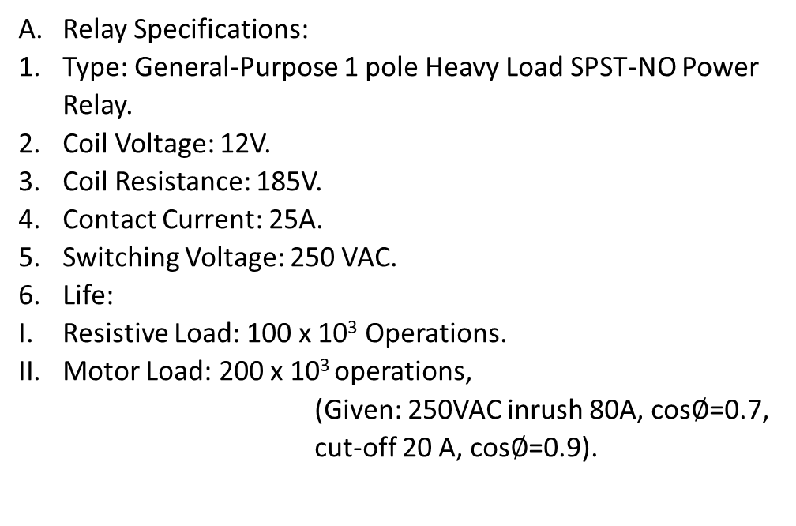
Moisture and Temperature Sensor Specifications:
Model No: EC-1258.
Working Voltage: 5V.
Working current: <20mA.
Interface Type: Analog
Working Temperature: 10⁰C ~ 30⁰C.
pH Sensor Specifications:
Model No: FPH-BTA.
Type: Double-Junction, Sealed, gel-filled, polycarbonate body, Ag/AgCl.
Response Time: 90% of final reading in 1sec in a buffer.
Temperature Range: 5 to 80⁰C.
pH Range: 0-14.
Accuracy: ± 0.2 pH units.
Isopotential pH: pH 7.
Shaft Diameter: 12 mm OD.
Relay Specifications:
Type: General-Purpose 1 pole Heavy Load SPST-NO Power Relay.
Coil Voltage: 12V.
Coil Resistance: 185V.
Contact Current: 25A.
Switching Voltage: 250 VAC.
Life:
Resistive Load: 100 x 10³ Operations.
Motor Load: 200 x 10³ operations,
(Given: 250VAC inrush 80A, cos$∅$=0.7, cut-off 20 A, cos$∅$=0.9).

